Slide 1
Topic: Efficient Addition Strategies EQ: What Are Efficient Addition Strategies?
Year 11 Essentials
Mrs Parlevliet

Slide 2
Things Required For This Lesson
Interactive Notebook
Textbook: Interleaved Maths Essential Connections
Ruler, Red Pen, Pencil, Pens, Scientific Calculator
Growth mindset

Slide 3

24
7
30
Topic: Efficient Addition Strategies
Date: 10/02/2021
EQ: What are efficient addition strategies?
WICOR
This Photo by Unknown Author is licensed under CC BY-SA

Slide 4


Task(LHS): Interleaved Questions Set 1 Page 133 Do as many as you can in 10 minutes.

Slide 5
Task (LHS) Think Pair Share
Determine the sum of 546 and 237 without a calculator.
Show your working out.
Compare your answer with the person next to you and discuss how you worked out the answer.
If you want to make changes to your working out or answer, make the changes underneath your original work.
Be prepared to contribute to a whole class discussion.

Slide 6
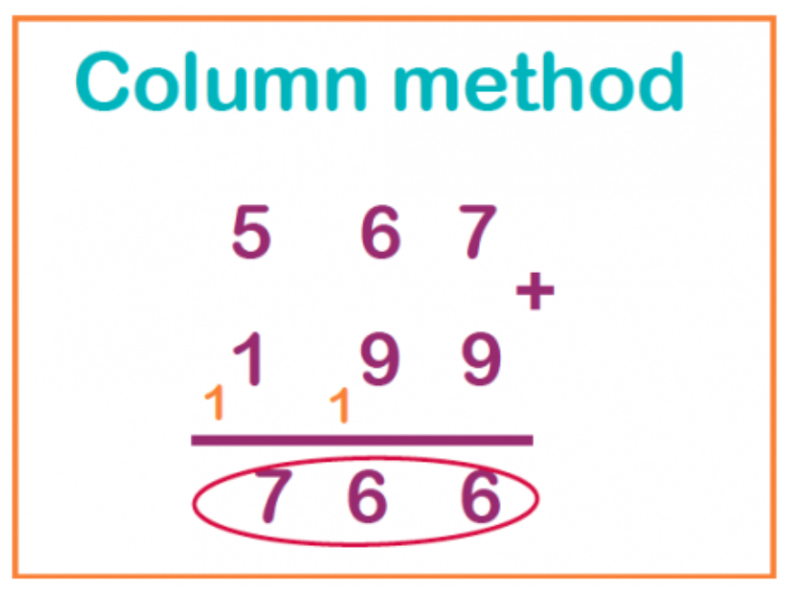
24
7
30
Topic: Efficient Strategies of Addition
Date: 10/02/2021
EQ: What are efficient strategies of addition?
Column Method Example $$567+199$$
WICOR
Notes:
There are many strategies used to add numbers. People have different methods for solving a problem. The key is to identify which strategy works best for you and the problem you are solving. The Column Method is probably something that most of you have seen and used in your many years of education.

Slide 7
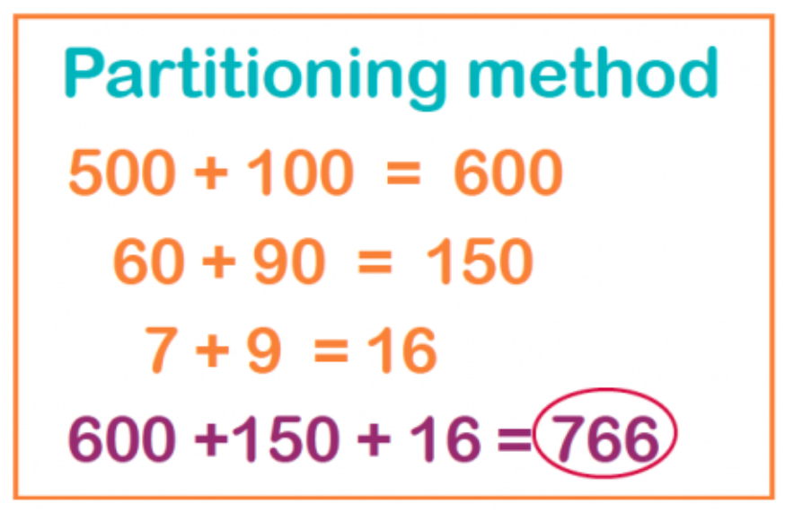
24
7
30
Topic: Efficient Strategies of Addition
Date: 10/02/2021
EQ: What are efficient strategies of addition?
Partitioning/Horizontal Format Strategy Example $$567+199$$
WICOR
Notes:
This strategy relies on you knowing how to add the place values of numbers and recombining them to get the final answer.

Slide 8










24
7
30
Topic: Efficient Strategies of Addition
Date: 10/02/2021
EQ: What are efficient strategies of addition?
Vertical Format Example $$567+199$$
WICOR
Notes:
This is the strategy from your textbook. You start adding from the left and write a number on each line below.

Slide 9

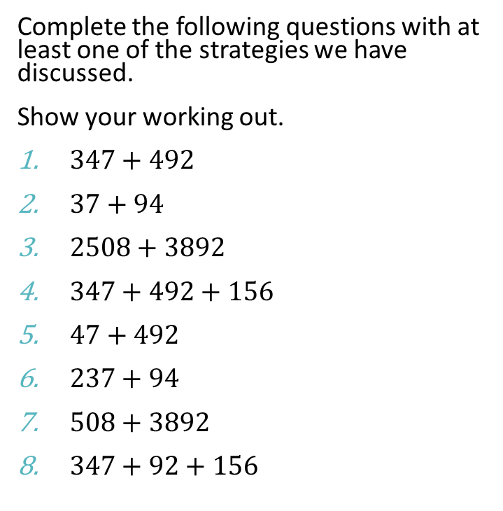
TASK (LHS) Questions
Complete the following questions with at least one of the strategies we have discussed.
Show your working out.
$347+492$
$37+94$
$2508+3892$
$347+492+156$
$47+492$
$237+94$
$508+3892$
$347+92+156$

Slide 10

TASK: (LHS) Questions
Now answer the questions using the Partitioning/Horizontal Format Strategy:
$49+492$
$237+94$
$508+3892$
$347+92+156$
Check your working out with the person next to you.
Be prepared to discuss and share your answers with the class.

Slide 11

Think, Write, Pair, Share
What did you like about the strategies we have looked at today? Which did you prefer?
How do you think starting with the largest numbers might be useful for mental calculations?
Is there a way you could just use a single calculation to come up with a reasonable range for possible answers without calculating the whole lot?

Slide 12

Exit Ticket
Write your Summary including:
Which strategy you would use
Include your own example demonstrating the strategy you have chosen.
Show me your summary to get permission to pack up your belongings and stand behind your seat before being dismissed.
This Photo by Unknown Author is licensed under CC BY-SA-NC

